Slide 1
Disease Prediction
from Symptoms
Your Own Virtual Doctor!

Slide 2
Team Members
Yugansh Jain 184506
Peeyush Thakur 184510
Rohit Bhatia 184518
Tejesh Reddy 184528
Under The Guidance Of : Mr Gagnesh Kumar

Slide 3
Abstract
Disease Prediction plays an important role in health care information. It is important to diagnose the disease early. This project uses selective traits and classification strategies to diagnose and predict diseases. Adequate selection of features plays an important role in improving the accuracy of classification systems. The reduction in size helps to improve the overall performance of the machine learning algorithm. The use of differentiating algorithms in the disease database produces promising results by developing flexible, automated and intelligent diagnostic programs for diseases. Classification systems can be used to speed up the process and improve the efficiency of result statistics. This work introduces a comprehensive overview of the options for selecting various features and their pros and cons. We then analyzed the flexible classification systems and classification systems for the same stages of disease forecasting.

Slide 4
Contents
Project Idea & Objective
Phases of the project
Tools & Tech Stacks
Briefing of each phase
Wrapping things up
01
02
03
04
05

Slide 5
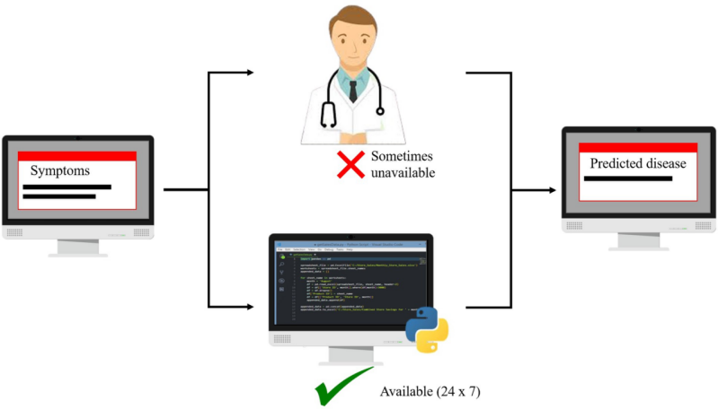
Project Inspiration
Medicine and healthcare are some of the most crucial parts of the economy and human life. In this situation, where everything has turned virtual, the doctors and nurses are putting up maximum efforts to save people’s lives even if they have to danger their own. Virtual doctors are board-certified doctors who choose to practice online via video and phone appointments, rather than in-person appointments but this is not possible in the case of emergency. Machines are always considered better than humans as, without any human error, they can perform tasks more efficiently and with a consistent level of accuracy.

Slide 6
Objective
The primary goal was to develop multiple models to define which one of them provides the most accurate predictions. While ML projects vary in scale and complexity, their general structure is the same.
A disease predictor can predict the disease of any patient without any human error. Also, in conditions like COVID-19 and EBOLA, a disease predictor can be a blessing as it can identify a human’s disease without any physical contact.

Slide 7
Phases of the project
01
02
Data Collection & Pre-Processing
The most essential stages to acquire the fine and final data that can be taken as correct and suitable for further data mining tasks.
Model Training
Determining good values for all the weights and the bias from labeled examples.
We used different classifiers to compare the results namely
Decision Tree Classifier
Support Vector Machine

Slide 8
Tools & Tech Stacks
Data Collection & Pre-processing:
Scikit-learn
Pandas
Numpy
Matplotlib
Model Training:
Scikit-learn
Decision Tree
Support Vector Machine
Collaboration tools:
Google Colab
Google Docs
Latex

Slide 9
Data Collection & Pre-processing
Phase 01
Data Collection : Data collection is the systematic approach to gathering and measuring information from a variety of sources to get a complete and accurate picture of an area of interest.
Data Pre-processing : Data preprocessing is a data mining technique which is used to transform the raw data in a useful and efficient format which can be further feed into a model for training.
Why Data Pre-processing is required?
Since mistakes, redundancies, missing values, and inconsistencies all compromise the integrity of the set, you need to fix all those issues for a more accurate outcome. Thus, before using that data for the purpose you want, you need it to be as organized and “clean” as possible. There are several ways to do so, depending on what kind of problem you’re tackling.

Slide 10
Data Collection & Pre-processing
Phase 01
Data Source : https://people.dbmi.columbia.edu/~friedma/Projects/DiseaseSymptomKB/index.html
Database based on disease-symptom associations generated by an automated method based on information in textual discharge summaries of patients at New York Presbyterian Hospital admitted during 2004.
We will use this data by copying it in an excel file and using it.
We will firstly clean the data, so that we can further process the data to feed into the model.

Slide 11
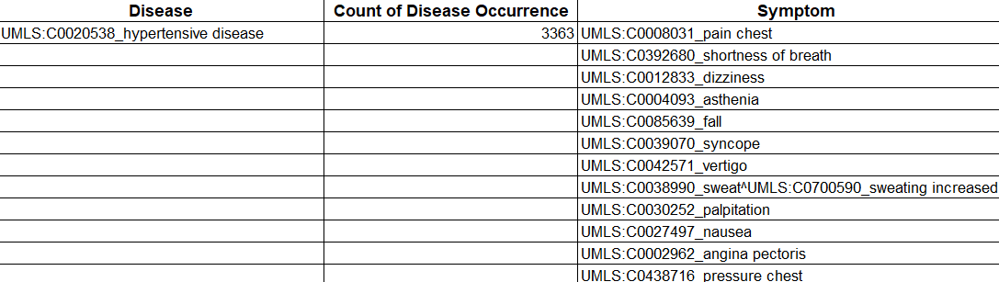
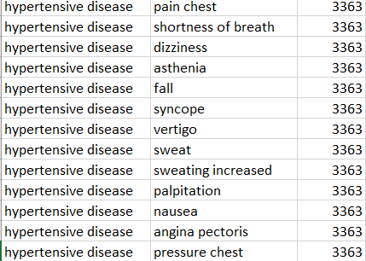
Data Images (Snippet) before and after Cleaning
Phase 01
Before :
After :

Slide 12
Encoding
Phase 01
After cleaning data we will use Label Encoder and One Hot Encoder. These two encoders are parts of the SciKit Learn library in Python, and they are used to convert categorical data, or text data, into numbers, which our predictive models can better understand.
Label Encoding is a popular encoding technique for handling categorical variables. In this technique, each label is assigned a unique integer based on alphabetical ordering.
With one-hot, we convert each categorical value into a new categorical column and assign a binary value of 1 or 0 to those columns.
After, encoding our data will be ready to feed in model for training process.

Slide 13
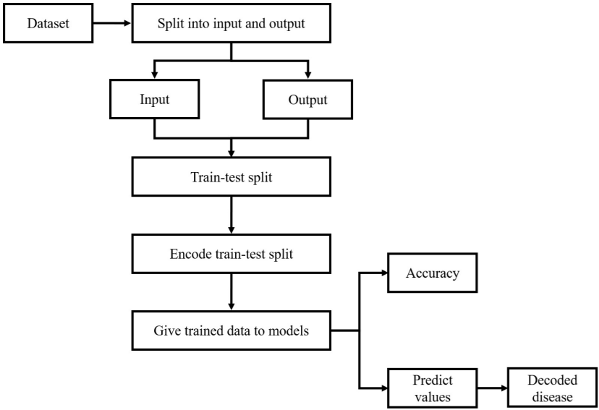
Flow chart

Slide 14
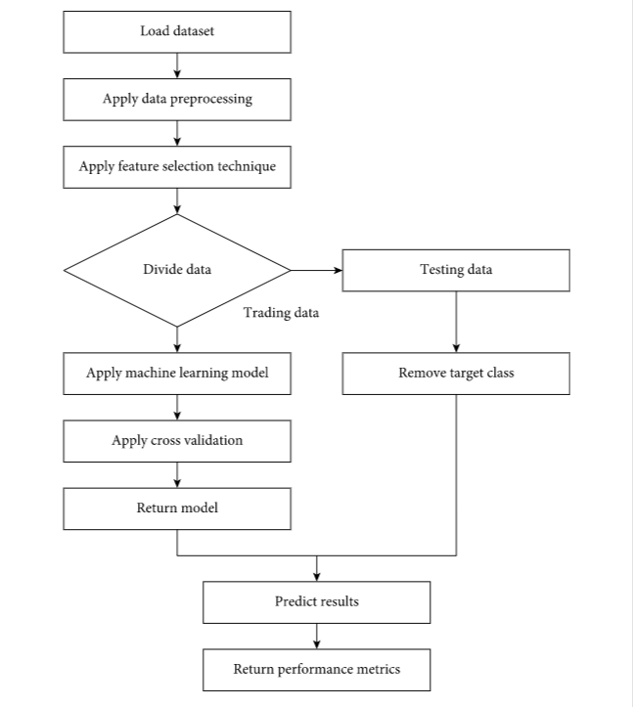
Principal Aspects

Slide 15
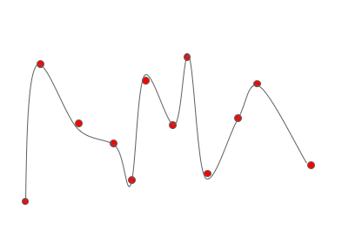
Model Training
Phase 02
How to choose the right model for the project? Things to consider
01
02
03
04
Size of the dataset
Training time
Number of features
Availability of computational time and power
Too many features can cause the model to overfit and make it imprecise.
Trying too hard to overfit!
Continued.

Slide 16
Model Training
Phase 02
How to tackle the problem of large number of features?
Large number of features can cause the training time of the model to increase exponentially.
Feature selection: If no statistical relationship exists between some features, drop the insignificant one.
Manual Feature Selection: Selected through data analysis.
Feature Engineering: Group certain features which have some relevance.
PCA: Reducing the dimensionality of our dataset.

Slide 17
Model Training
Phase 02
Decision Tree
Decision Tree
Support Vector Machine
The goal of using a Decision Tree is to create a training model that can use to predict the class or value of the target variable by learning simple decision rules inferred from prior data(training data). In Decision Trees, for predicting a class label for a record we start from the root of the tree.
01
02
Support-vector machines SVMs, also Support-vector networks are supervised learning models with associated learning algorithms that analyze data for classification and regression analysis.
Support Vector Machine

Slide 18

Results using Decision Tree

Slide 19
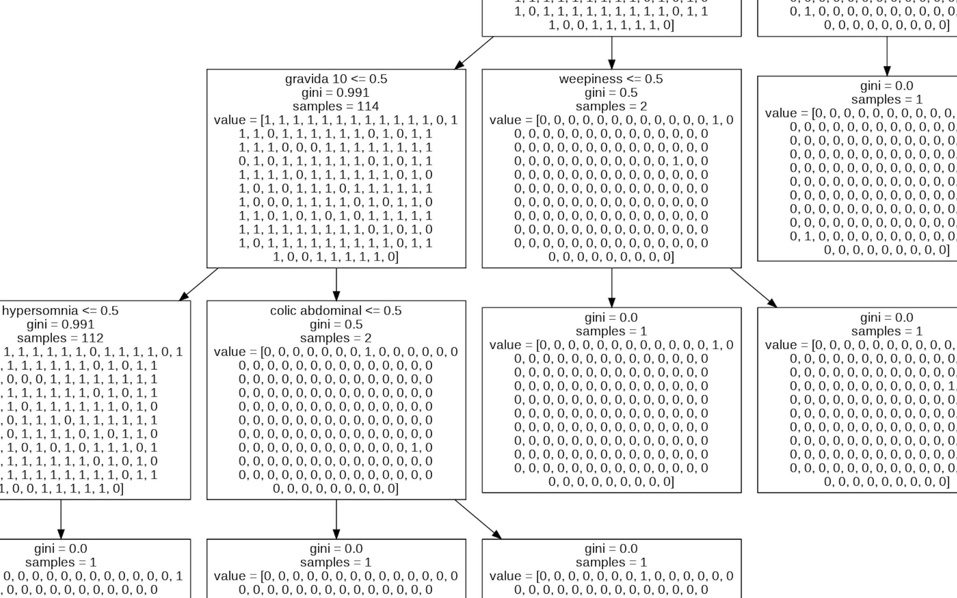
Single Block Representation
Accuracy which we got using Decision Tree is 97.3154
We also used SVM to compare the accuracies and the accuracy which we got by SVM is 98.1132

Slide 20
Why did we use two different algorithms ?
To find and compare the accuracy of our model.
The goal of using a Decision Tree is to create a training model that can use to predict the class or value of the target variable by learning simple decision rules inferred from prior data (training data). In Decision Trees, for predicting a class label for a record we start from the root of the tree.
Major complexity is with the algorithms and mathematical concepts behind them.

Slide 21
Potential Uses in day-to-day life
Wrapping Things Up
Many types of illness can be prevented by just stopping in its beginning phase. This project envisages to help patients with mild symptoms to check for any possibility of disease.
This early detection can help the patient visit the doctor within time and get treated fast and economically.
Thus this project have potential to accomplish the following:
1. (Primarily) save many lives from diseases,
2. Save time and money by early detection.

Slide 22


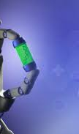
Thank you!
We thank you for your time for having a look at our project.

